Slide 1

scanf语句与printf语句

Slide 2
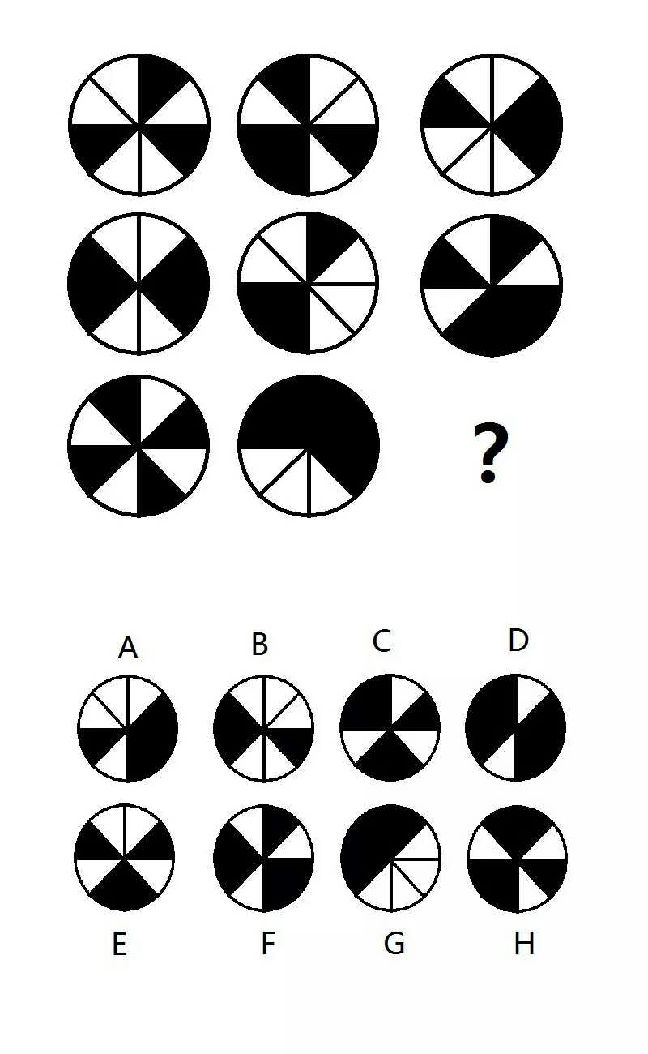

Slide 3


Slide 4


